Slide 1


Alpha USA Bank
Management System
Group 2
Zoya, Khushboo, Mathew, Riya, Tetiana, Elena

Slide 2
Class Relationships
Bank HAS A Employees
Fulltime Employee IS A Employee
Parttime Employee IS A Employee
Bank HAS A Customers
Business Customer IS A Customer
Individual Customer IS A Customer
Bank HAS A Accounts
Saving Account IS A Account
Checking Account IS A Account

Slide 3
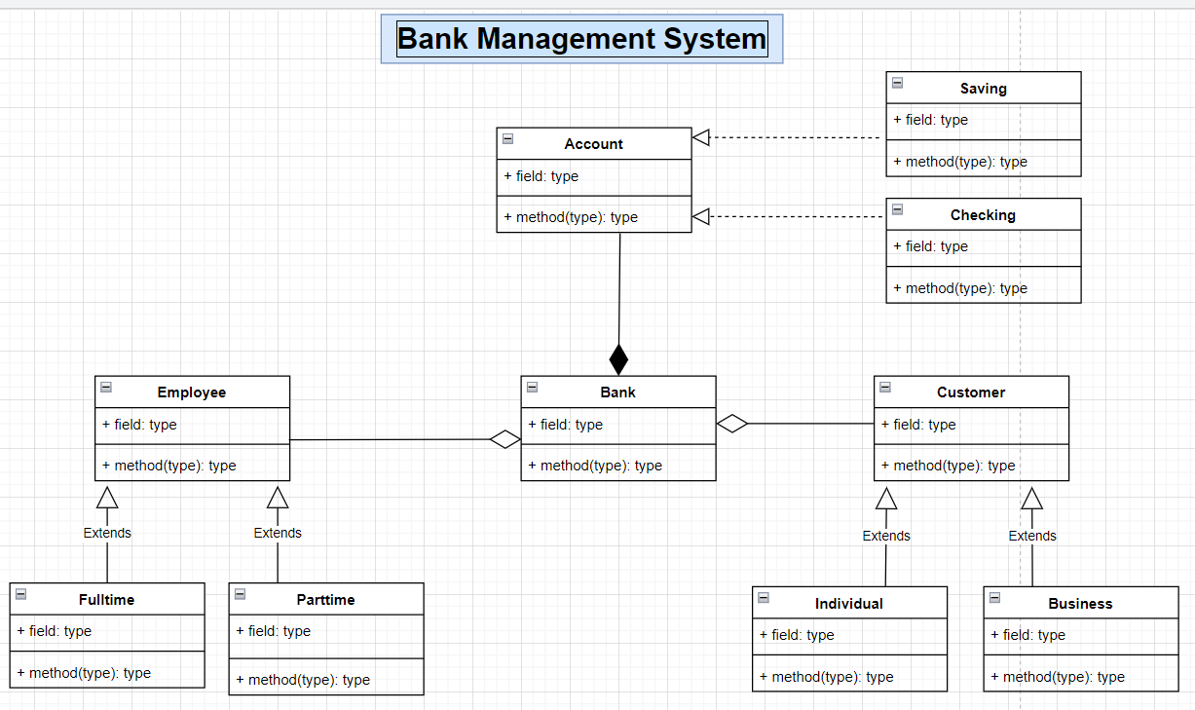
Class Diagram

Slide 4
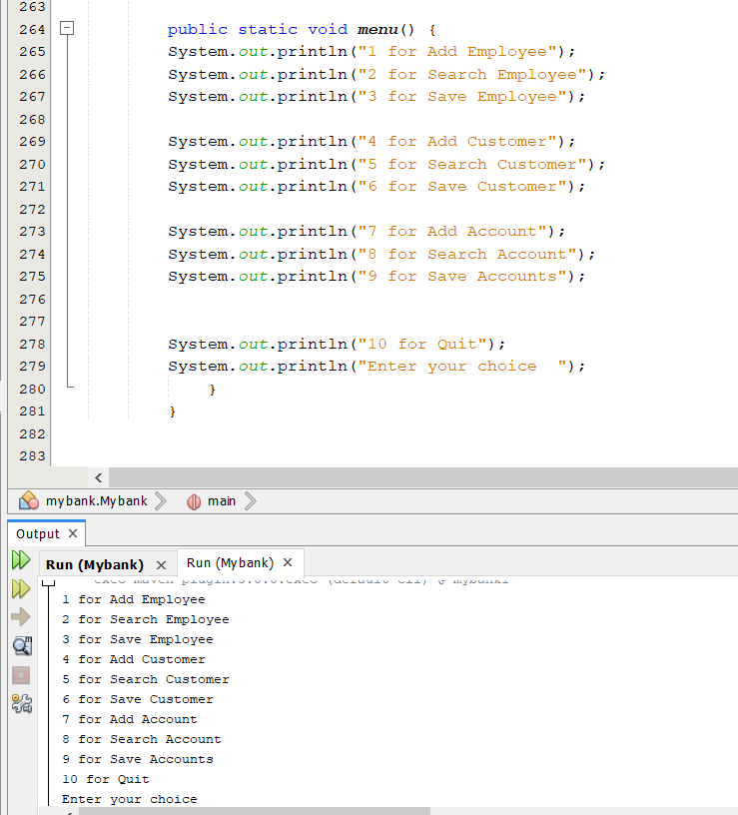
Bank menu

Slide 5
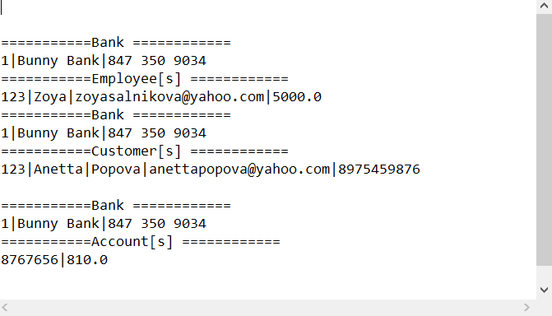
File Writer/Buffer Writer

Slide 6
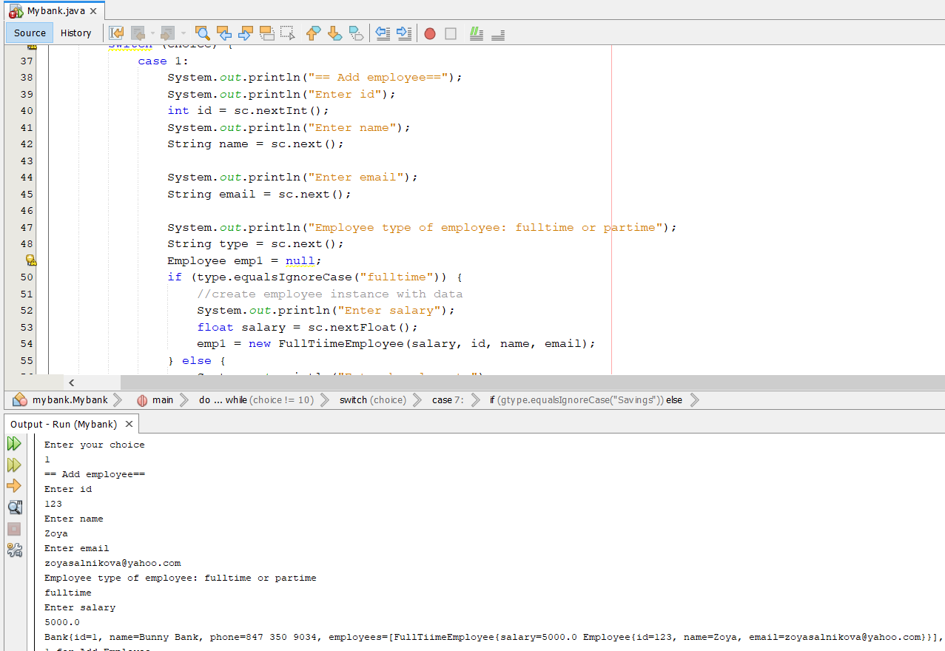
Add Employee Feature

Slide 7
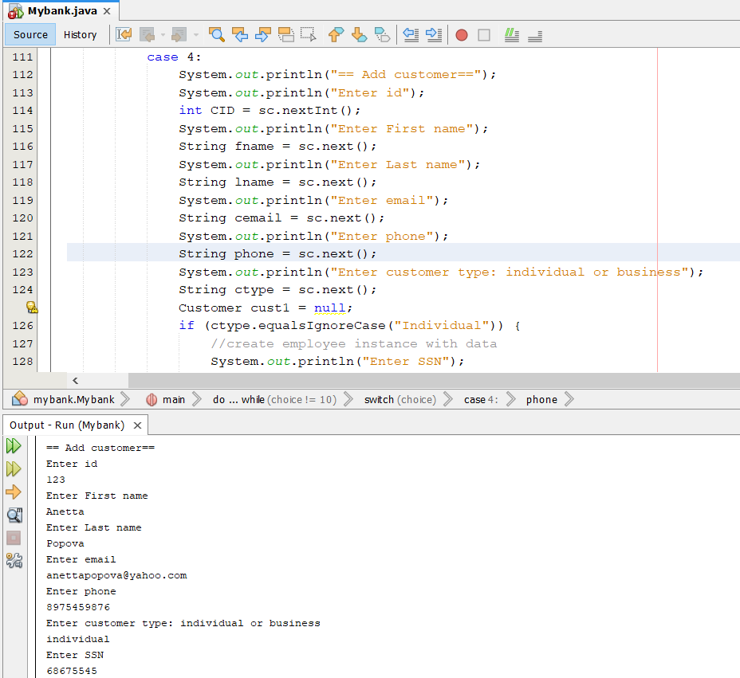
Add Customer Feature

Slide 8
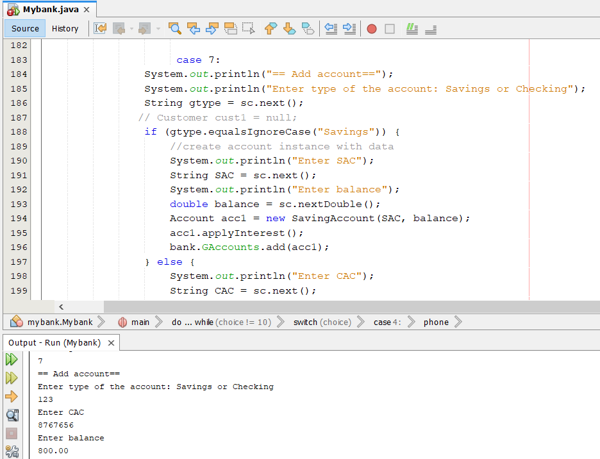
Add Account Feature

Slide 9
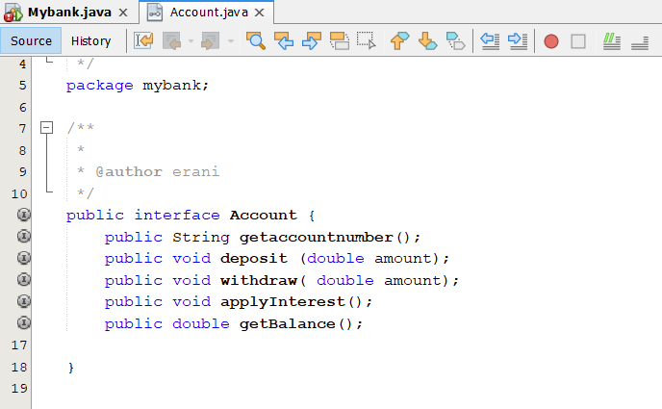
Interface Implementation

Slide 10
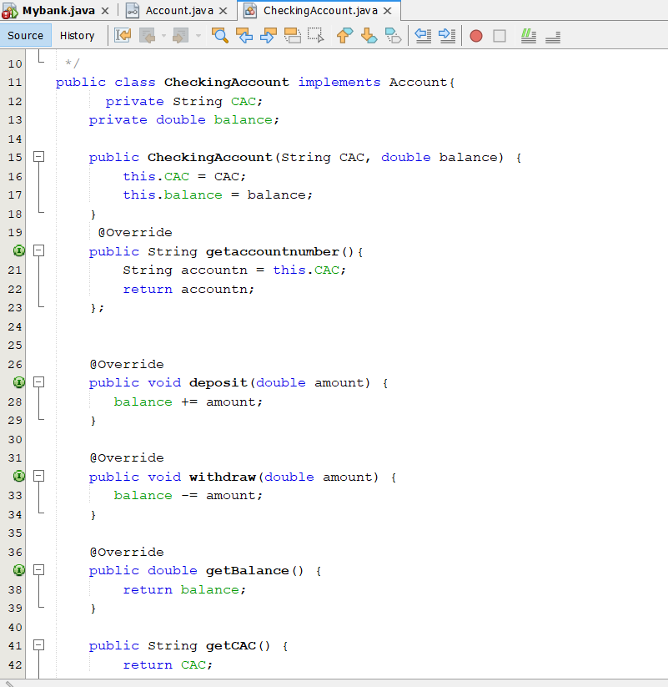
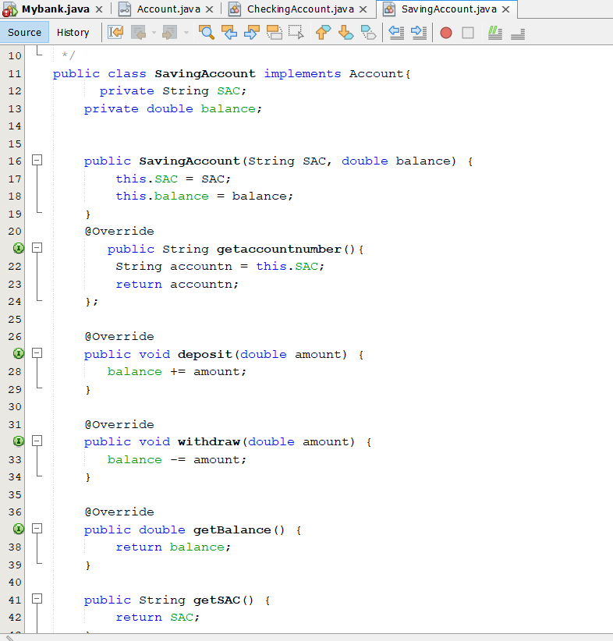
Class Relationships

Slide 11
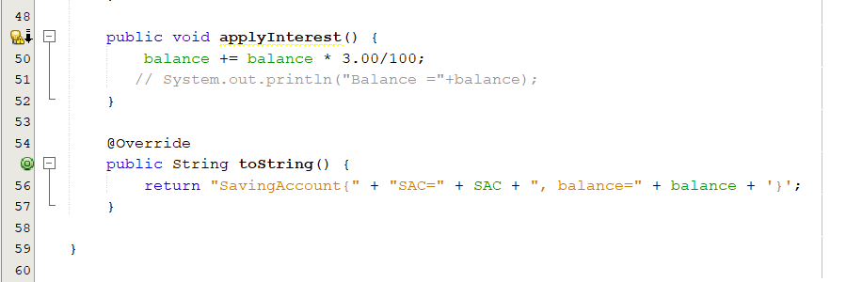
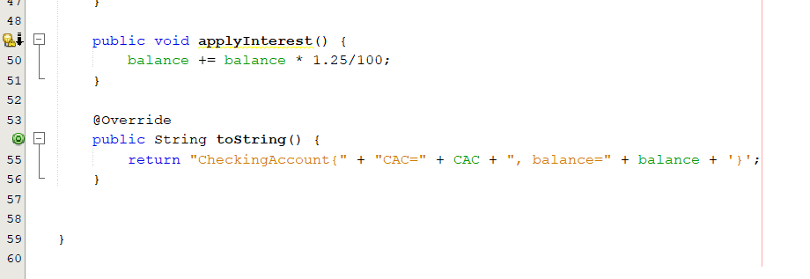

Slide 12
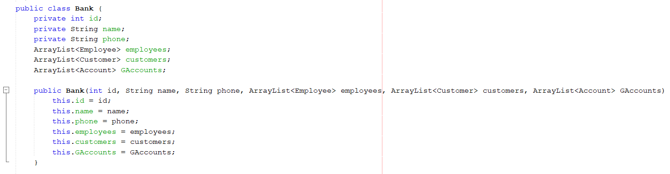
HAS A Relationships Implementation

Slide 13
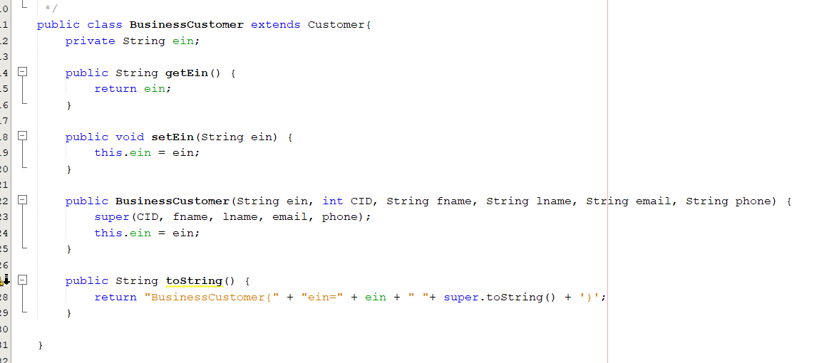
IS A Relationships implementation

Slide 14
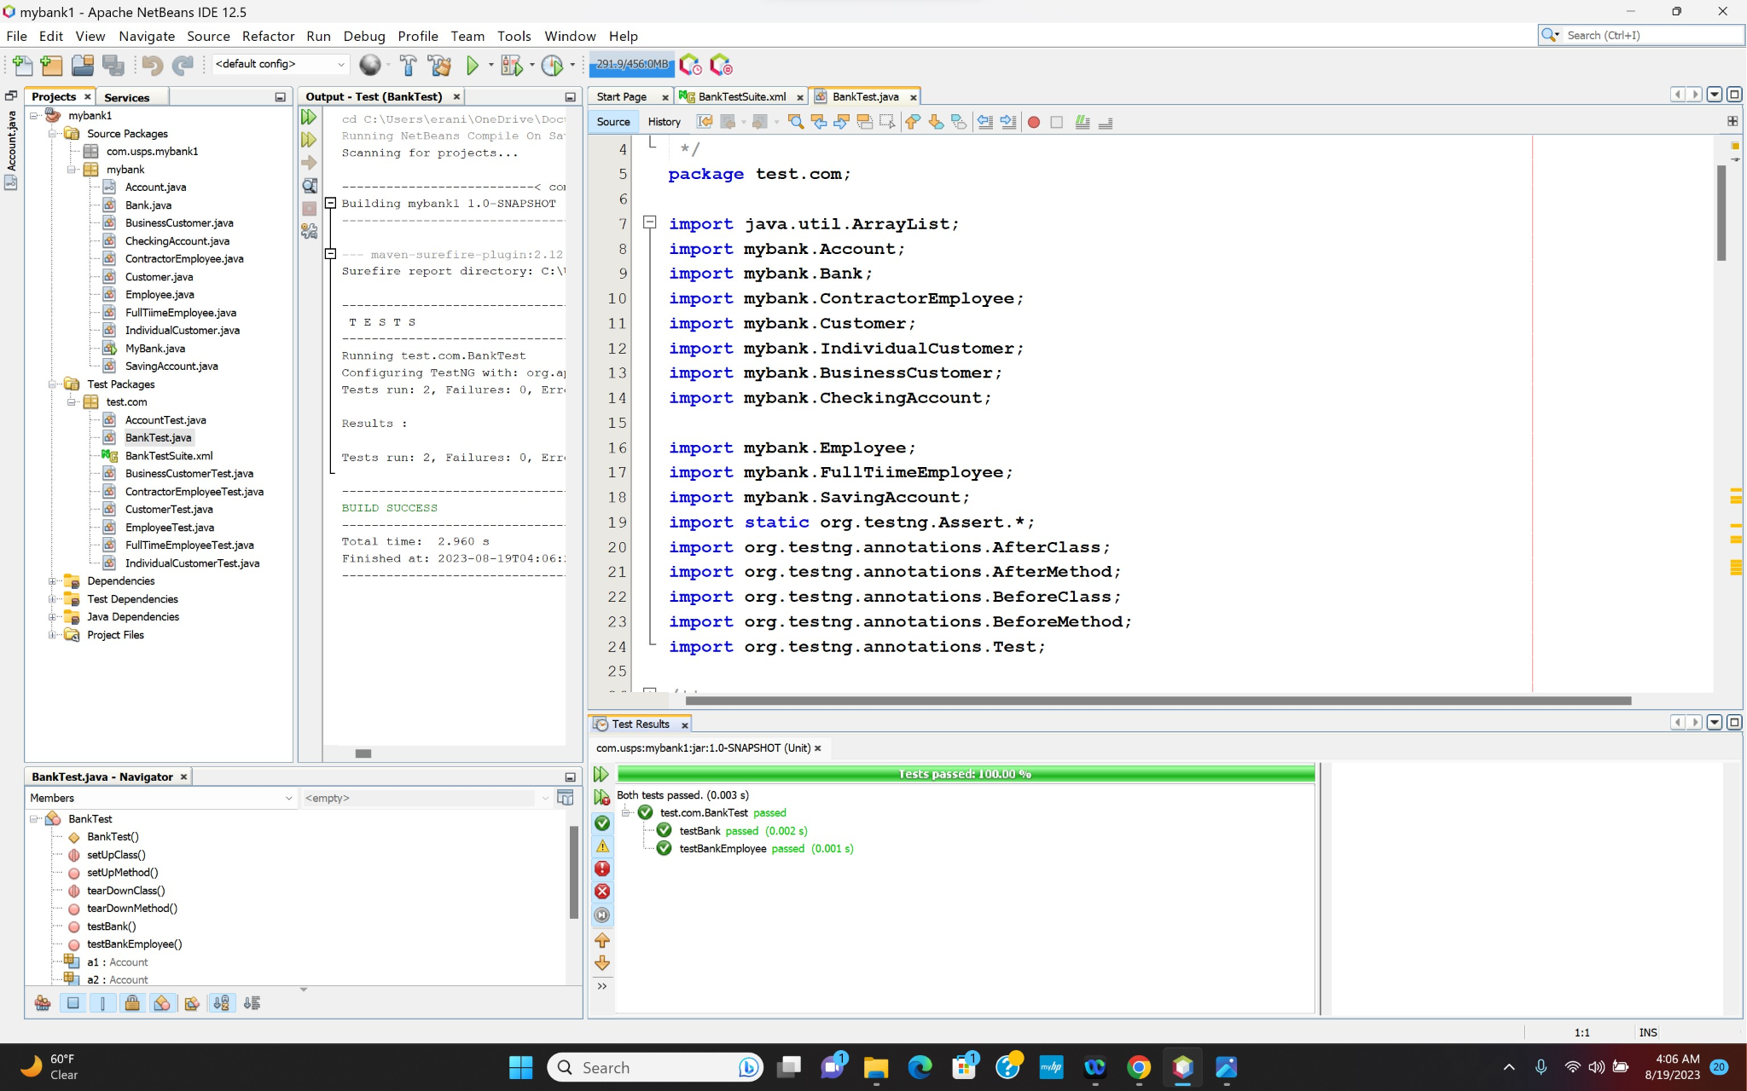
TestNG Unit Test
Notes:
Thank you Zoya. Hello Everyone My name is mathew and I will talk about how we tested our project with TestNG unit test and TestNG Suite and also will show the report added code coverage to our project.

Slide 15
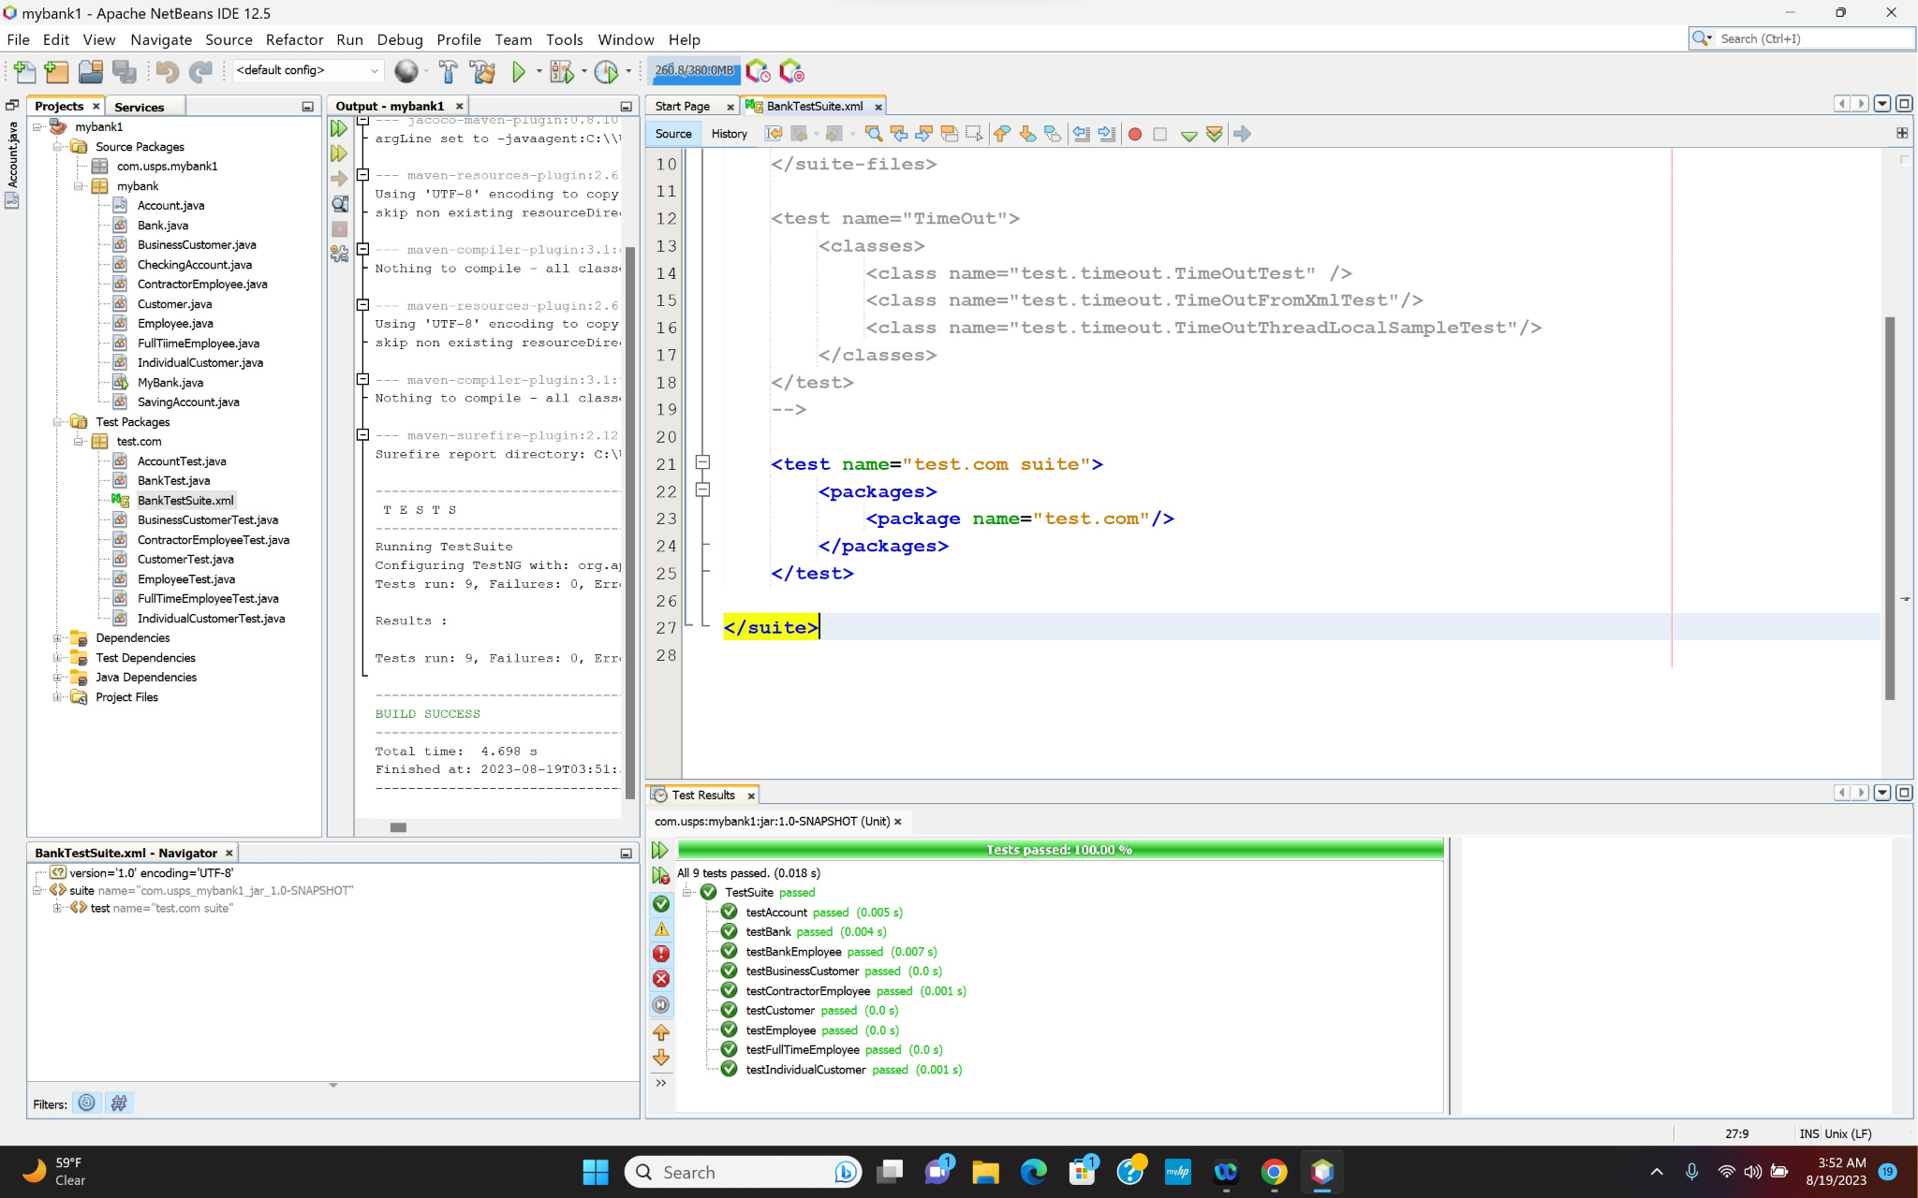
TestNG Suite Test
Notes:
Thank you Zoya. Hello Everyone My name is mathew and I will talk about how we added code coverage to our project.

Slide 16
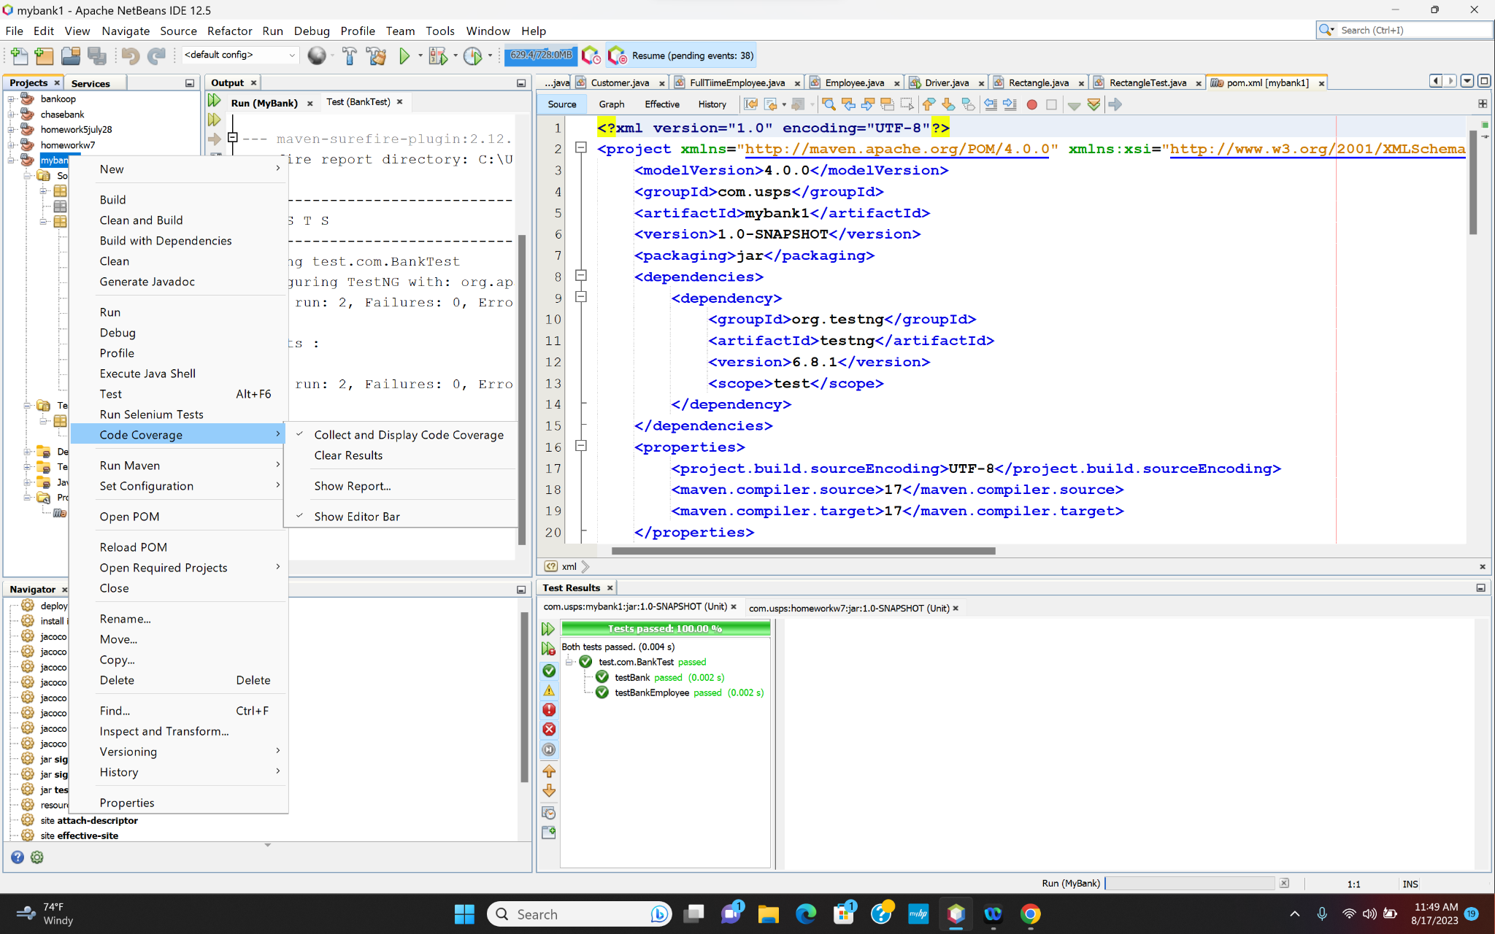
Code Coverage
Notes:
Thank you Zoya. Hello Everyone My name is mathew and I will talk about how we added code coverage to our project.

Slide 17
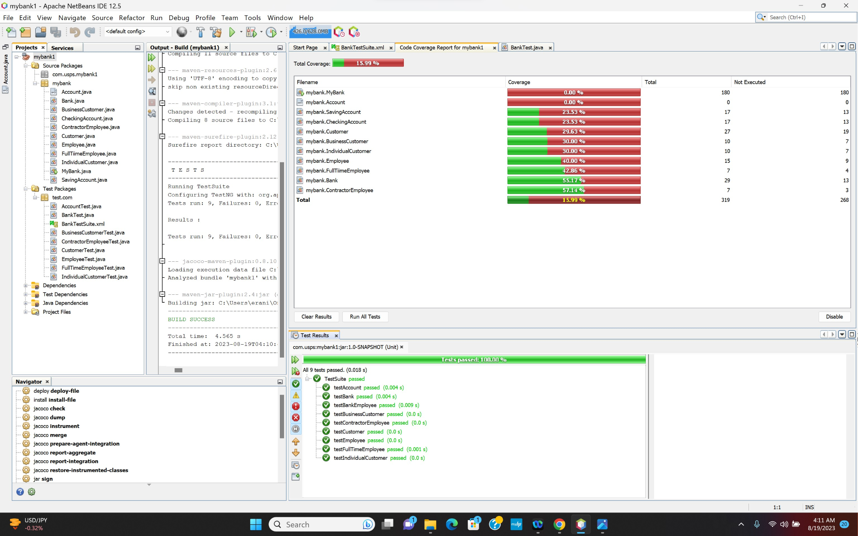
Code Coverage
Notes:
Thank you Zoya. Hello Everyone My name is mathew and I will talk about how we added code coverage to our project.

Slide 18
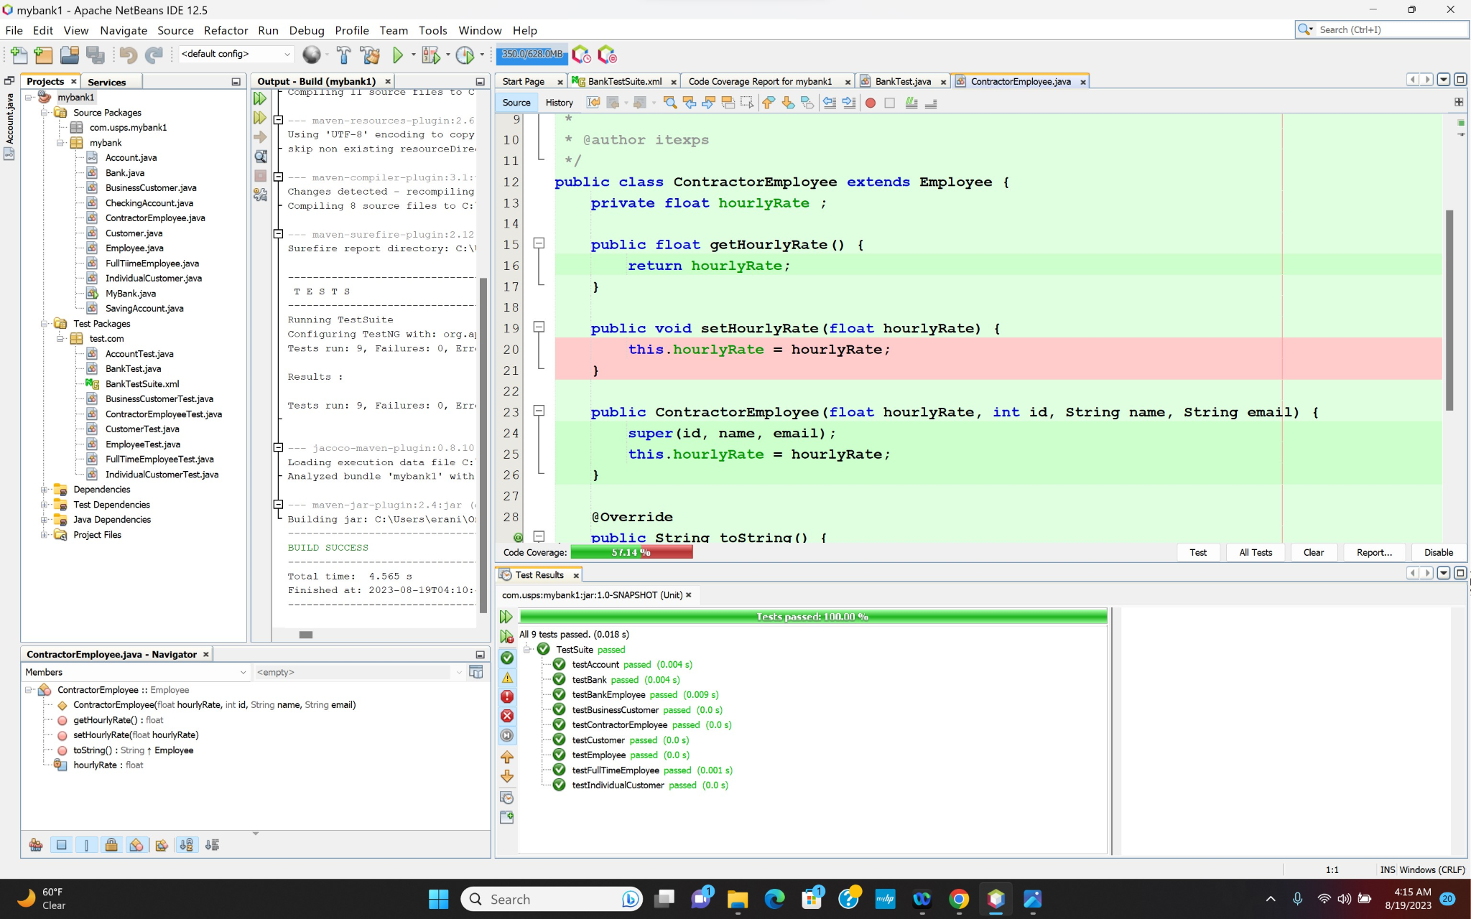
Code Coverage
Notes:
Thank you Zoya. Hello Everyone My name is mathew and I will talk about how we added code coverage to our project.

Slide 19
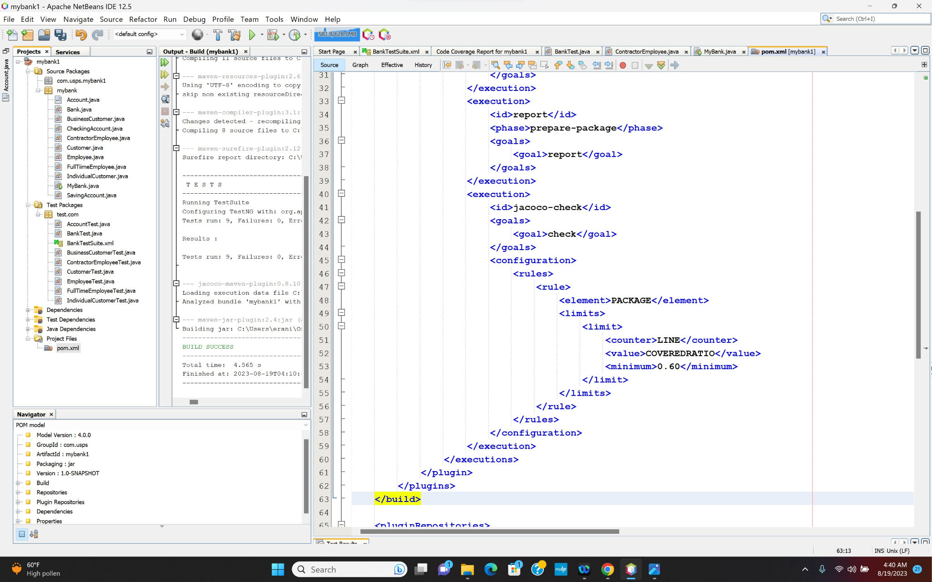

Slide 20
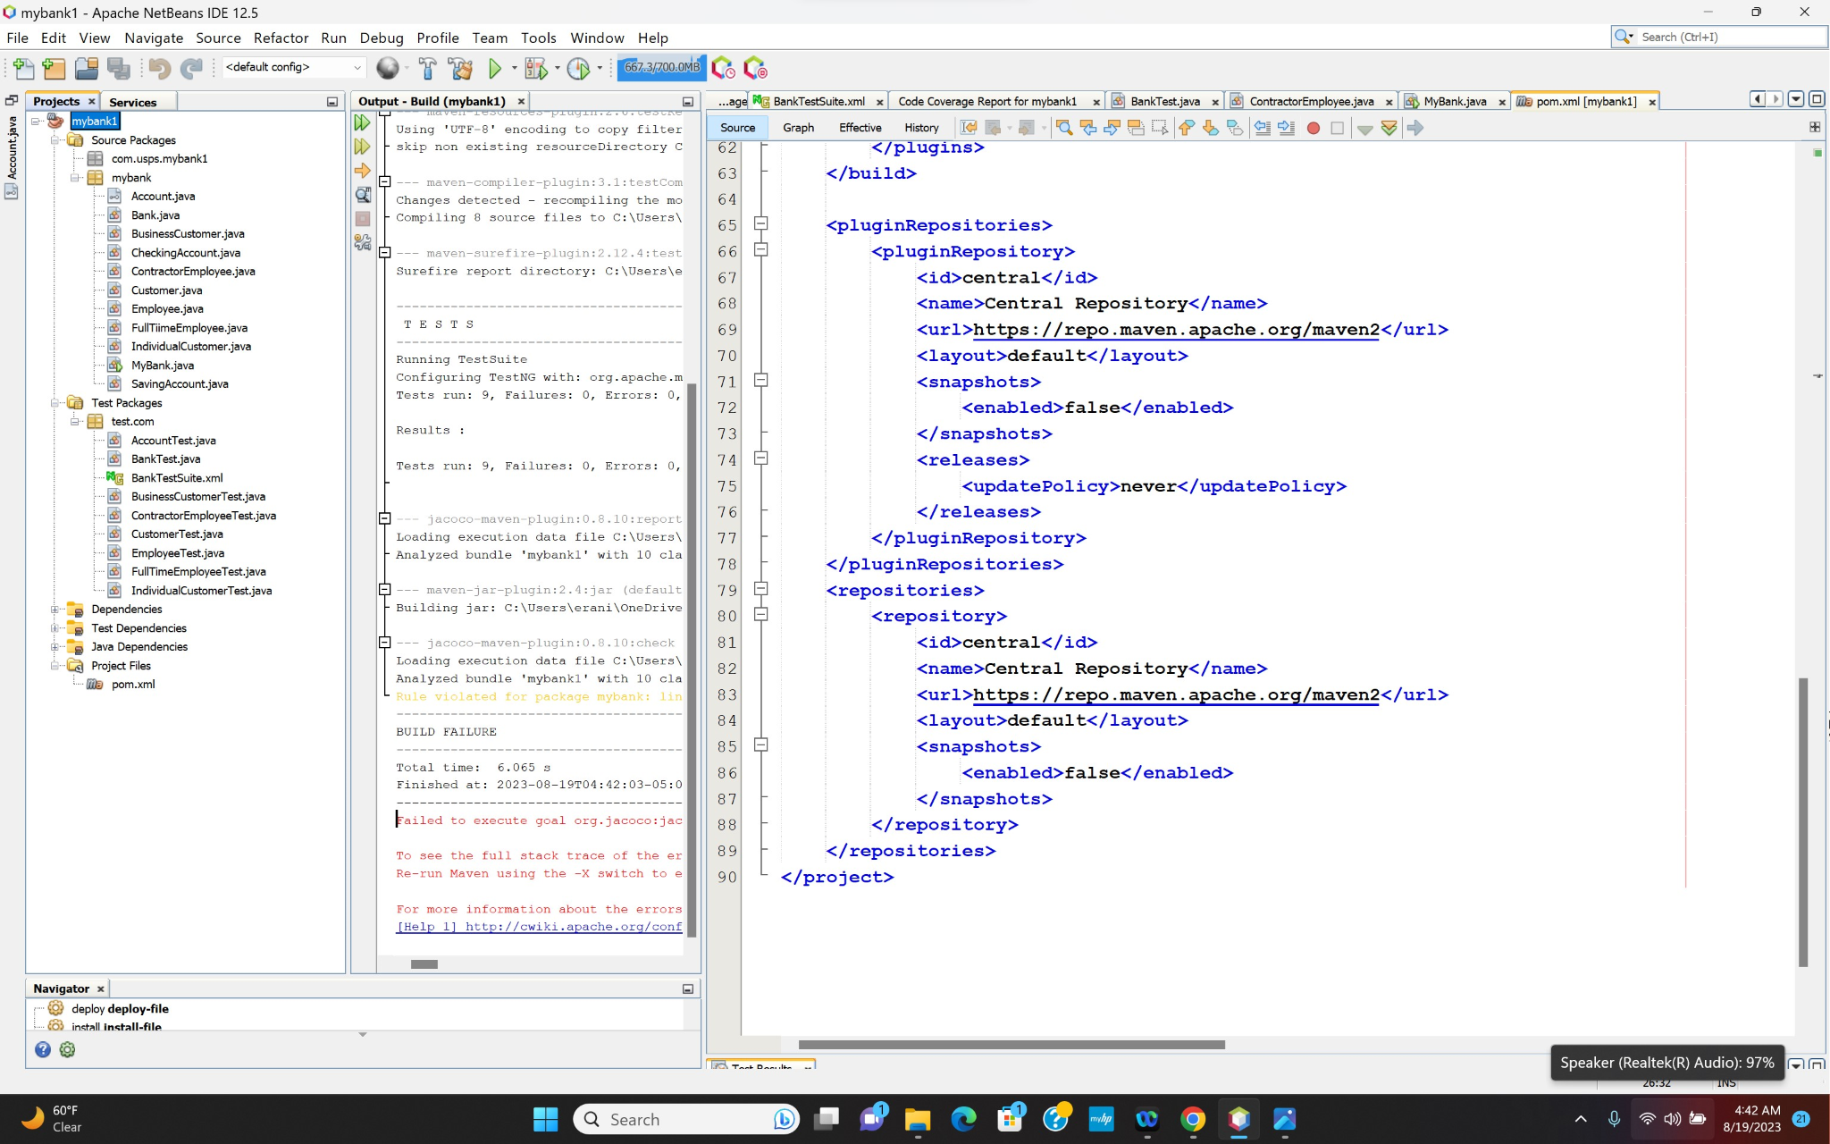
Clean And Build

Slide 21
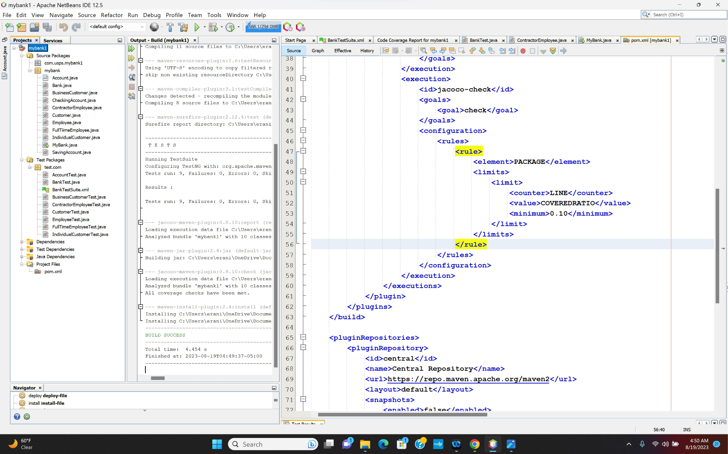

Slide 22
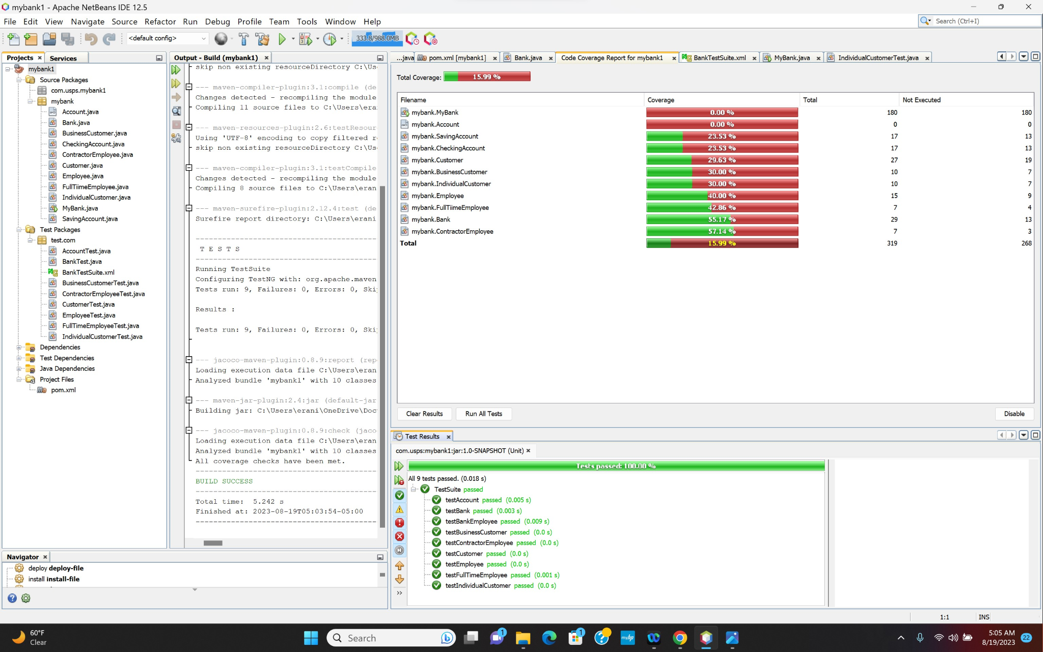

Slide 23
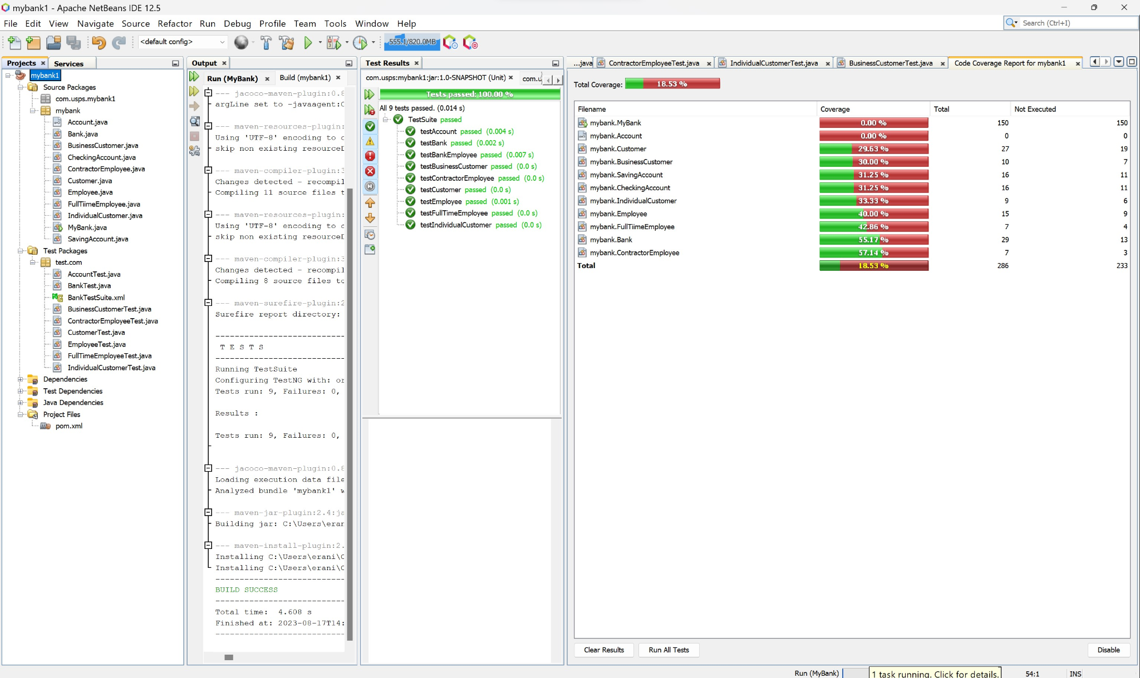
TestNG Suite Test & Code Coverage
Notes:
This is our test cases with our code coverage report. We made multiple test cases for each class. I will now pass this over to Tetiana.

Slide 24









Tools

Slide 25

Any Questions?

